Slide 1
ComEd Employees who received the vaccine were asked… why is getting the vaccine important to you?
ComEd Dupage, IL Clinic - April 22, 2021

Slide 2
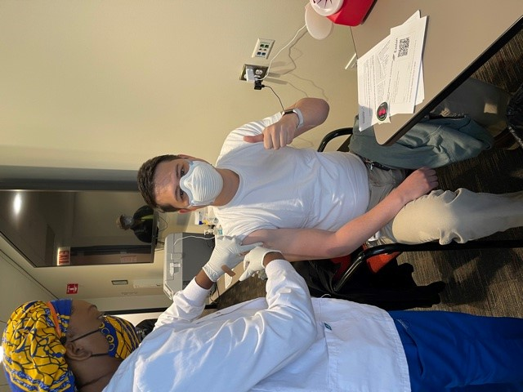
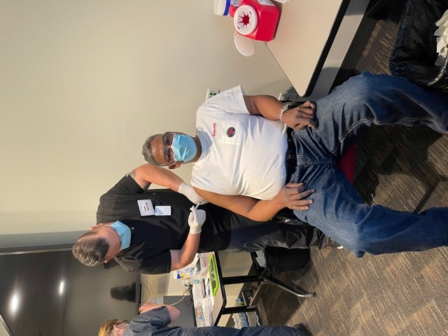
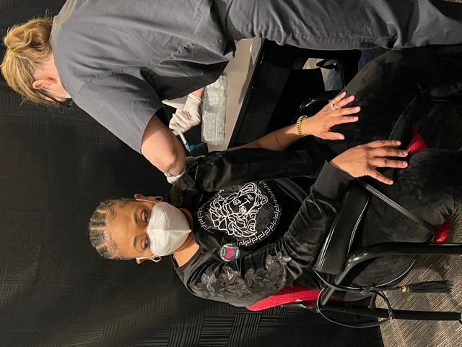
Schereina Horton- “I am ready to travel”
“I want to see my Mom and Dad” Curtis Bundy
“It’s great that the company did this for us, the vaccine has been pretty hard to find!”- Jesse Bauer

Slide 3
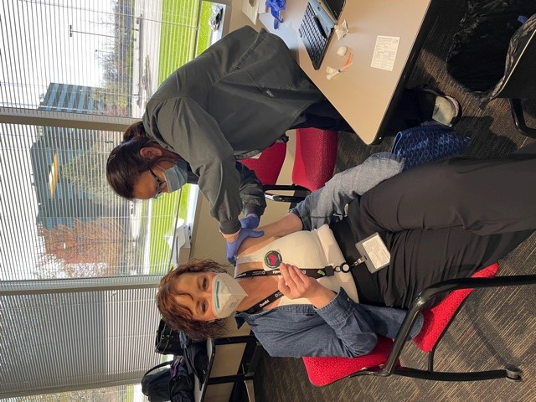
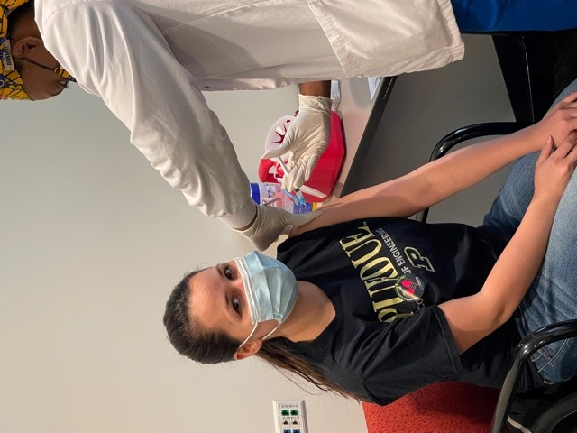
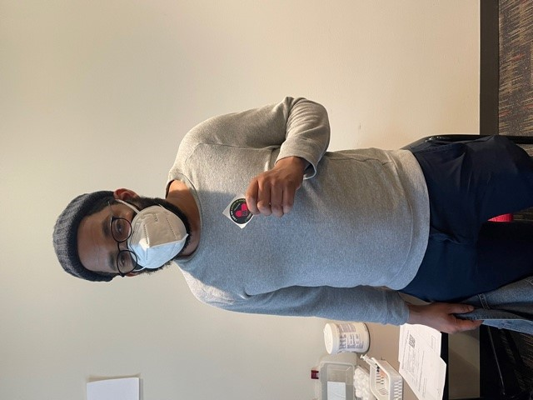
“Excited for this vaccine!” –Kerri Charlton
Jessica Rudolphi -“wants life to get back to normal, -just doing my part to get back to that”
“So I can leave the house safely” – Maureen Zurek
“To stop this disease”- Terrance Johnson

